Slide 1
Sleep disorder Analysis
Sleep disorders are a growing health concern affecting both physical and mental well-being. Quality sleep is essential for maintaining productivity, emotional balance, and overall health. This project performs an exploratory data analysis (EDA) to study factors influencing sleep disorders. The dataset includes demographic, lifestyle, and occupational variables such as age, stress level, physical activity, and sleep duration. The analysis aims to identify key patterns and insights that can help understand and improve sleep health.

Slide 2
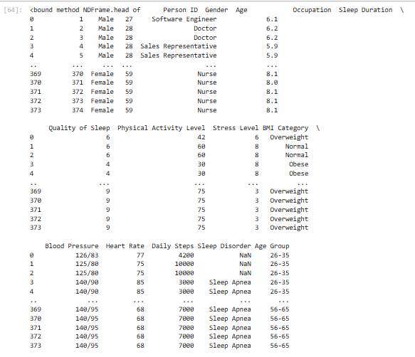

Data Loading

Slide 3
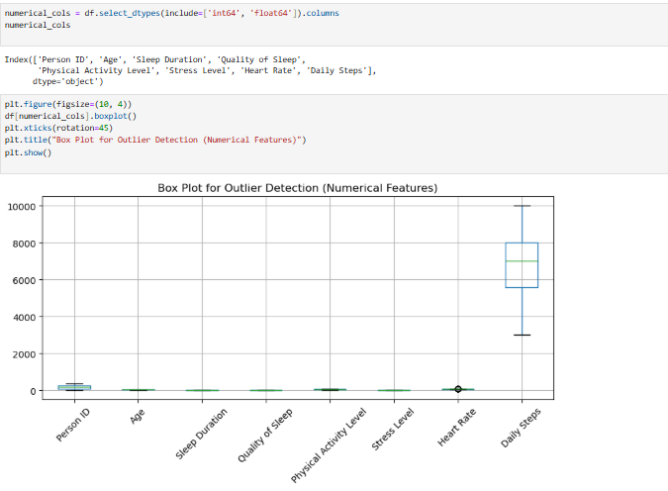
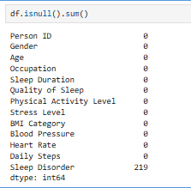
Data Preprocessing

Slide 4
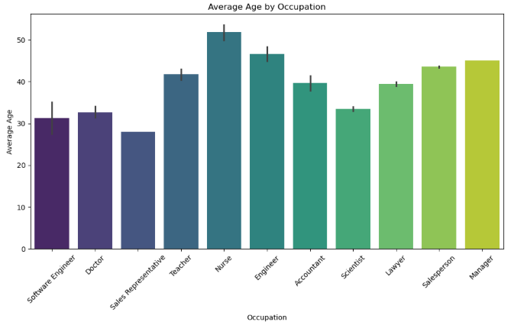

Graph of Occupation vs Average age groups

Slide 5
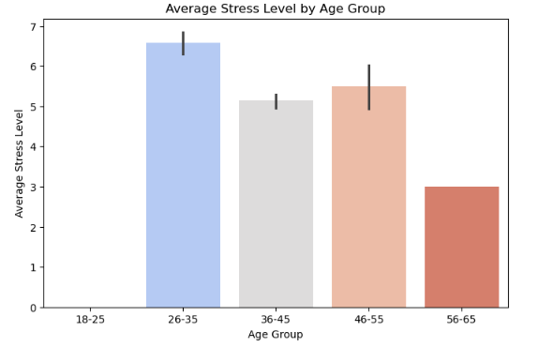
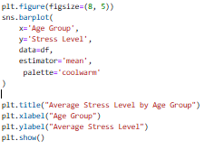
Graph of average stress level by age group

Slide 6
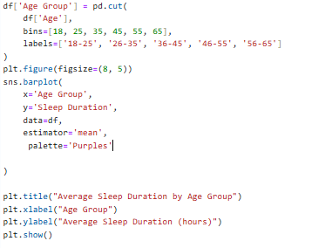
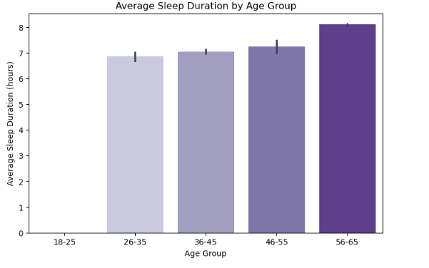
Graph of Average Sleep Duration by Age Group

Slide 7
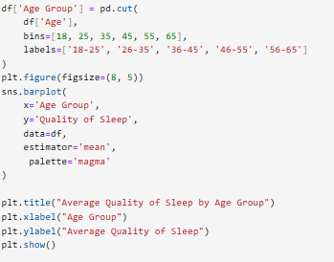
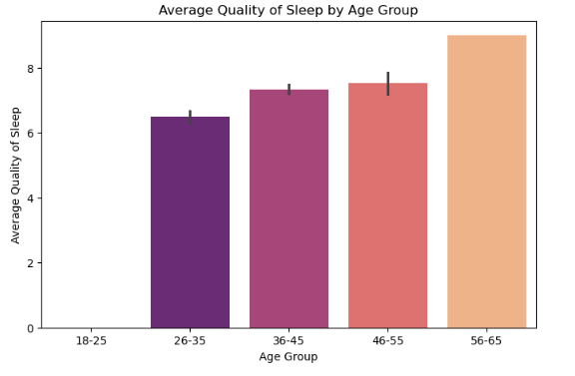
Graph of average quality of sleep by age group

Slide 8
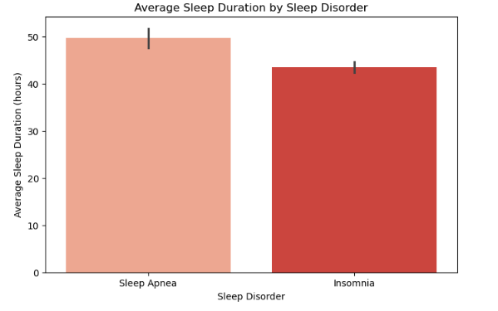
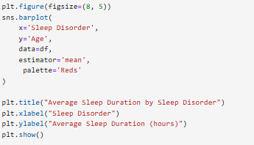
Graph of Average Sleep Duration by Sleep Disorder

Slide 9
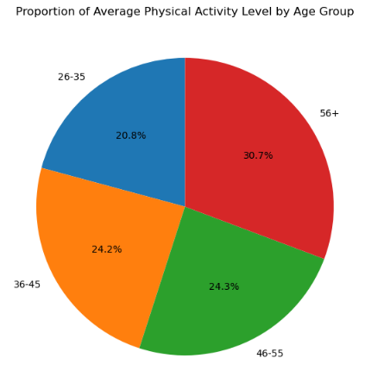

Proportion of average physical activity

Slide 10
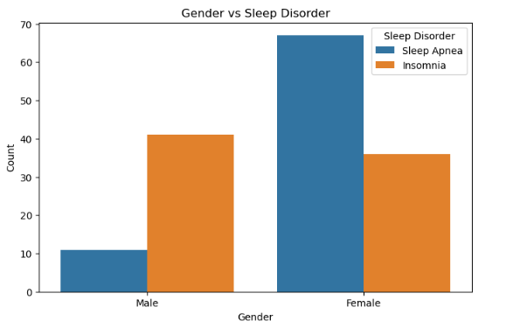
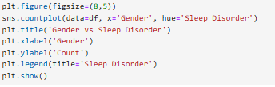
Comparison of sleep disorder based on gender

Slide 11
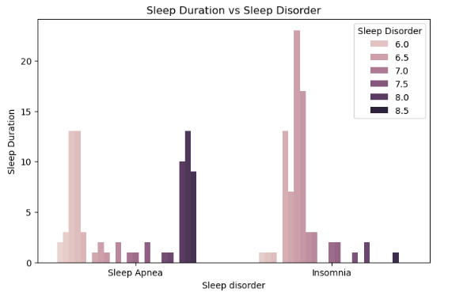

Graph of sleep duration vs sleep disorder

